Slide 1
DEPRECIATION

Slide 2
Depreciation
Def: The decrease in the value of machine or asset with the lapse of time
In accounting terms, depreciation is defined as the reduction of recorded cost of a fixed asset in a systematic manner until the value of the asset becomes zero or negligible.

Slide 3
Types /causes of depreciation
Depreciation due to wear and tear
Depreciation due to physical decay (Buildings, furniture, electric wires etc)
Accidental depreciation
Depreciation due to wrong operation, loose parts which results in heavy damages.
Depreciation due to deferred maintenance and negligence.
Depreciation due to in adequacy (if demand increases than we may go for additional machinery or replace with latest machine)
Depreciation due to Obsolescence (Though the old machine is efficient becomes out of fashion and un economic, due to the new/better machine which has come in the market)(Becoming outdated)

Slide 4
METHODS FOR CALCULATING DEPRECIATION
Straight line method
Declining/Diminishing/Reducing balance method
Sum of the years digits method

Slide 5
Straight line method
Is also called as fixed installment method.
In this method every year a fixed amount is put aside as depreciation charges during the economical life of the equipment/machines.. The amount of depreciation,(initial cost of equipment including erection and installation charges – scrap value) is distributed over the useful life of the machine.

Slide 6
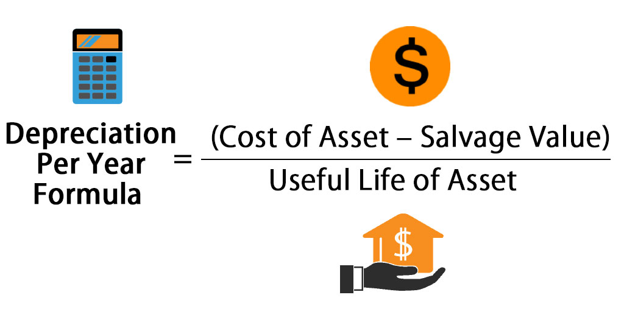
Formulae:
D = C – S
N

Slide 7
Example 1:
Cost of machine = 1,00,000/-
Salvage value = 0
Life of the equipment is = 10 years
Sol: D = C – S
N
i.e D = 1,00,000 – 0 = Rs.10,000/year
10

Slide 8
Example 2:
A machine costing Rs.24,000 was purchased on 1st December 1985. The installation and erection charges were Rs.1000 and its useful life is expected to be 10 years. The scrap value of the machine at the end of the useful life is Rs.5,000. Calculate the yearly depreciation by straight line method

Slide 9
Sol : D = C – S
N
i.e D = 24,000 +1000 – 5000
10
D = 2,000 /year

Slide 10
Declining/Diminishing balance method
The machine or equipment depreciates rapidly in the early years and later on slowly. Therefore according to this method the depreciation fund is more during the early years, when repairs and renewals are not costly. The book value of the machine goes on decreasing as its existence continues. Hence in this method a certain Percentage (%) of the current book value is taken as depreciation.

Slide 11
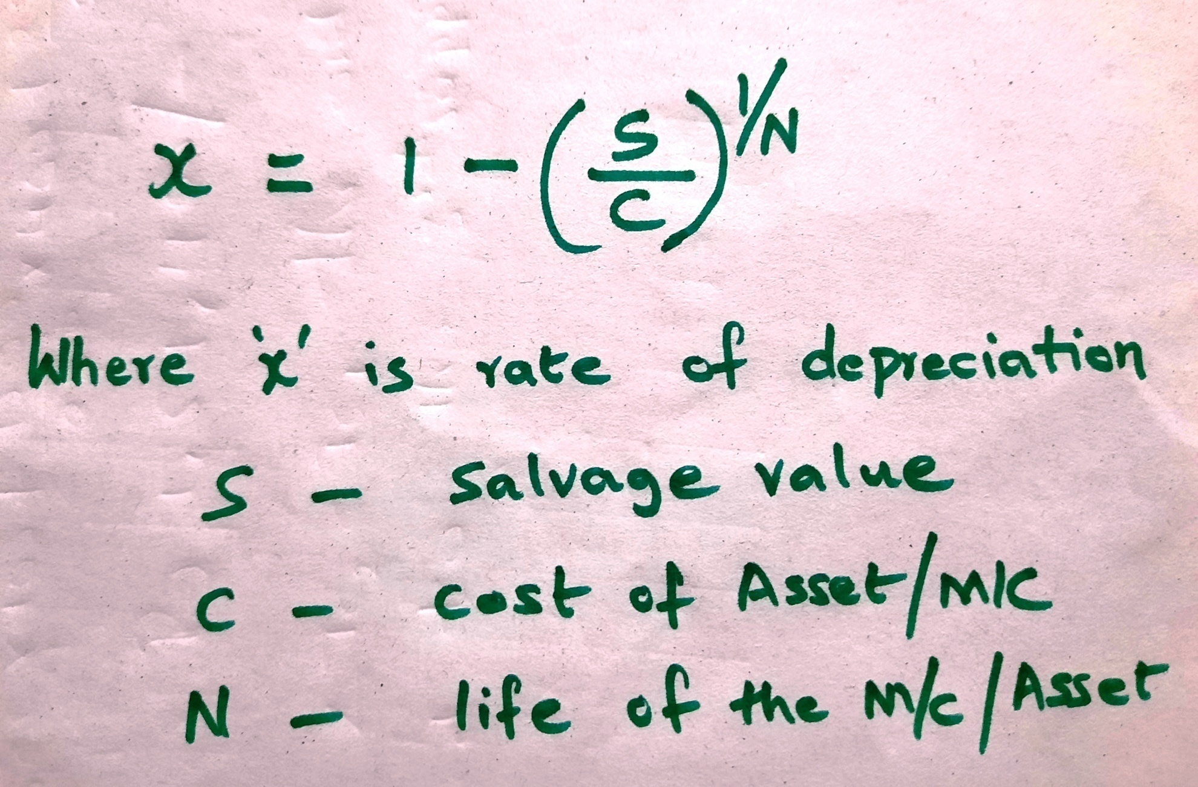
Formulae:

Slide 12
Example:1
Initial cost of the machine = Rs.1,00,000
Salvage value = Rs.10,000
Life in years = 8
Calculate the yearly depreciation using declining balance method.

Slide 13
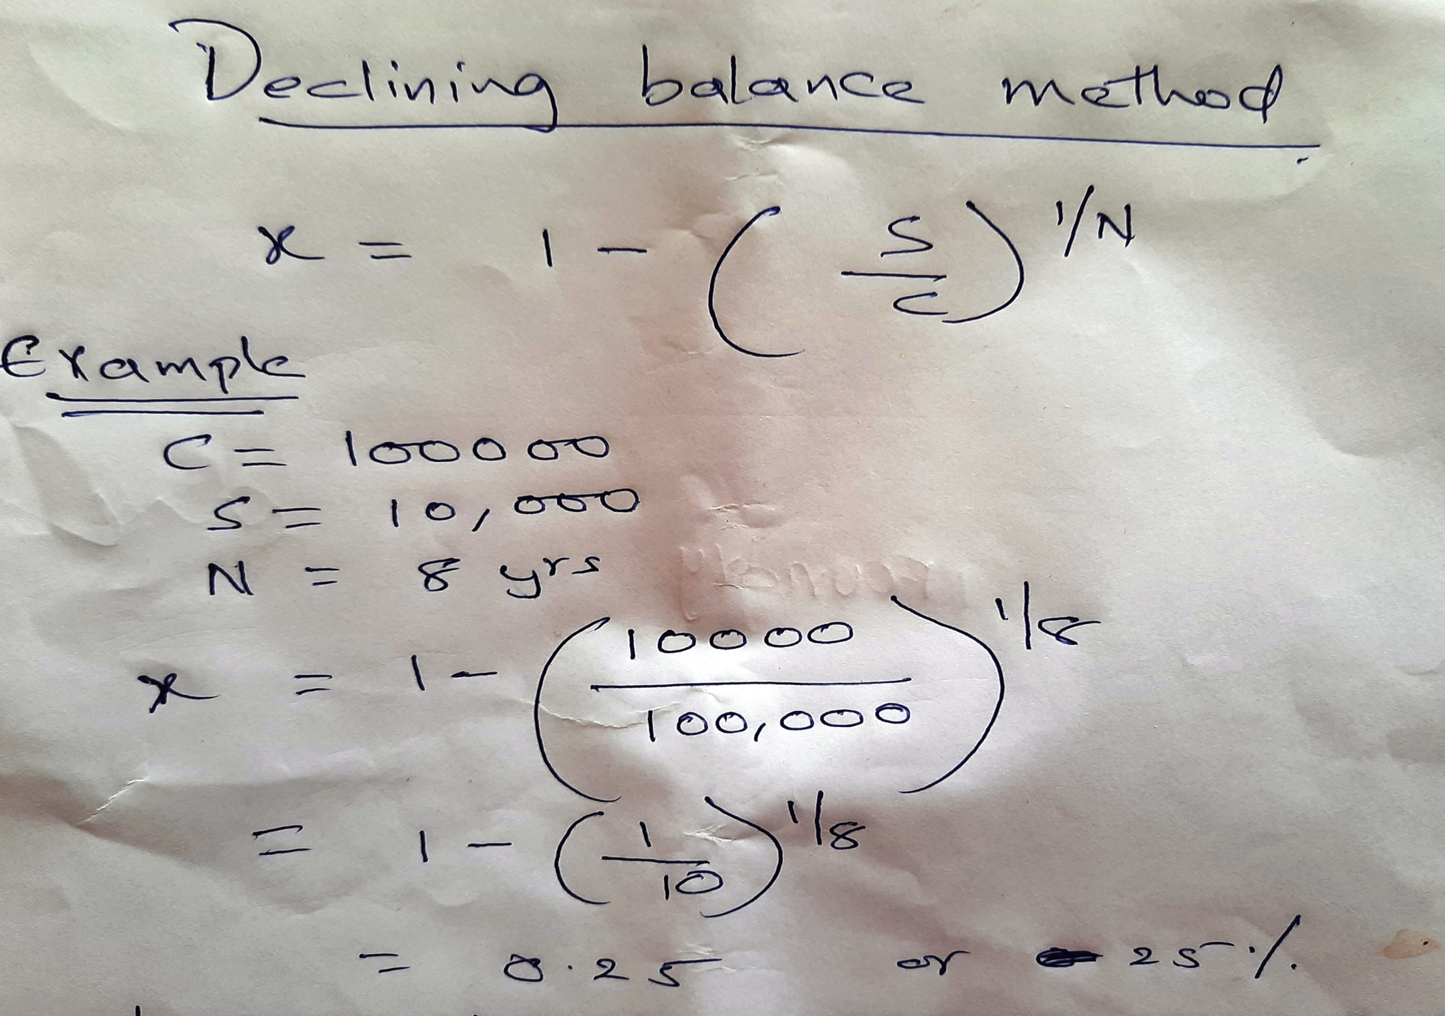

Slide 14
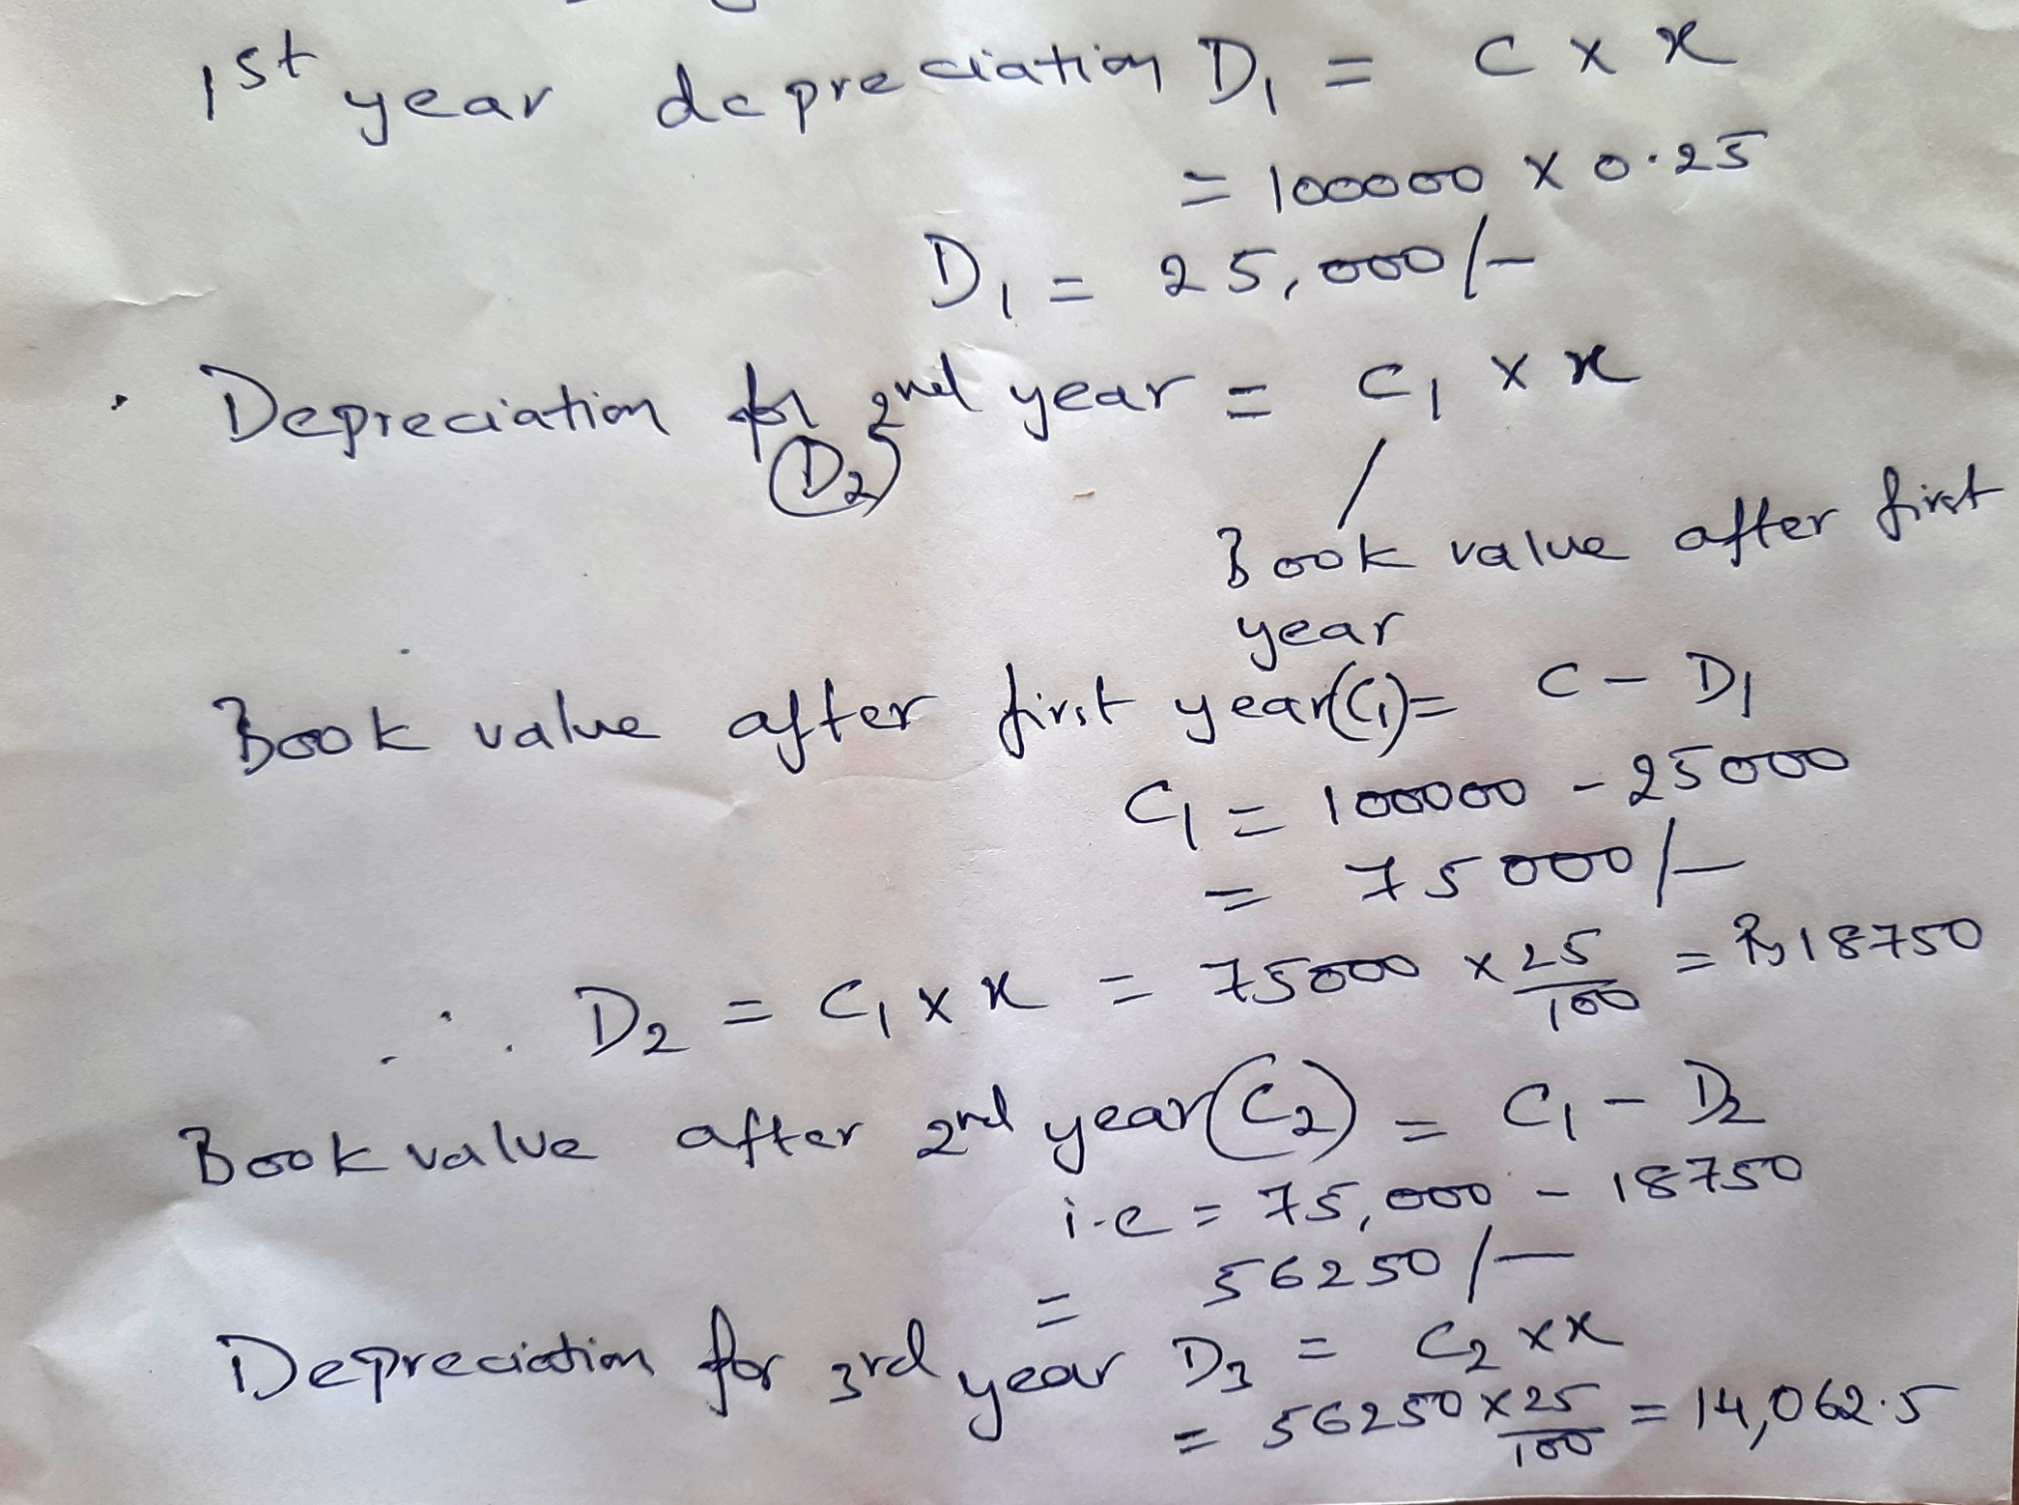

Slide 15
Example 3:
An asset has a first cost of Rs.60,000 with a salvage of Rs.5,000 after 11 years. If it is depreciated by declining balance method using a rate of 10 %. What will be the
Depreciation charge in the second year?
Depreciation charge in the Eight year?
Book value in the eight year?

Slide 16
Example 3:
An engine was purchased for Rs.20,000.Its useful life was estimated as ten years and the salvage value as Rs. 5,000.Using the diminishing balance method. Calculate the depreciation percentage (%).Also estimate the depreciation fund at the end of two years.

Slide 17
Sum of the years digits method
In this method the scrap value of the asset is deducted from its original cost and the remaining balance is spread over the assets life in decreasing proportion.

Slide 18
Example:1
C= 1,00,000
S=10,000
N = 5 years
Sol:
Sum of the years = 5+4+3+2+1 = 15
D₁ = 5/15 (1,00,000 – 10,000) = 30,000
D₂ = 4/15 (1,00,000 – 10,000) = 24,000
D₃ = 3/15 (1,00,000 – 10,000) = 18,000
D₄ = 2/15 (1,00,000 – 10,000) = 12,000
D₅ = 1/15 (1,00,000 – 10,000) = 6,000

